Slide 1
PCB Design Flow & backup files --HSCD

Slide 2
Design Flow
ME provide materials ( including DXF and emn ……)
Prepare
EE provide materials ( including SCH, Rule, Stack-up, guideline and so on)
Board Define and Lib path setup
Design In
Create Decal /Part Type
All Decal/Part Type OK？
No
Yes
Remind: Height limitation and Part balance
EE provide Placement and Routing Plan，specially：Power，RF，Analog signal and hi-speed signal Placement
Placement
RD/PSE check Placement
Modify Placement
No
Yes
Pads translate to Allegro
Refer to “PADS to Allegro SOP”, make sure Allegro symbols are all ready.
Setup rule
Reference routing plan to preferentially finish critical signal or area
Routing
RD check Routing
Modify Routing
No
Yes
Backup all equal length report to others folder
Clean up trace, DRC/power check,
constrain setup，add testpoints
Equal Length
DRC & Power check

Slide 3
Refresh all symbols
Create symbols
No
OK
Fine tune，Trace and Silkscreen clean up
Modify Issues
RD Final Check
No
Must take care of height limit, component, critical trace/area when modify any issue
OK
Gerber out
Follow Gerber out checklist
Modify Issues
No
CAM350 Check
Follow CAM350 checklist
OK
No
Valor Check
Valor check including open/short check, DRC check and power channel check
OK
Release Gerber and Spec to vendor
Next page
Backup all 6 files to SVN and Finished-project folder
Create Testpoint Version
Project Closed
Expert Check or ATE analysis
Add testpoint/clean up trace

Slide 4
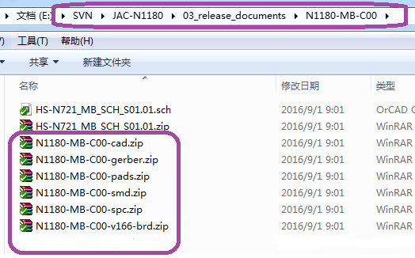
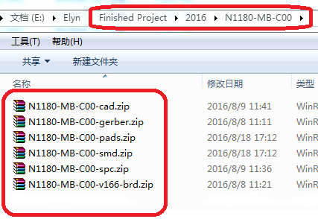
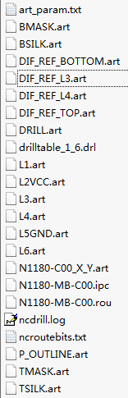
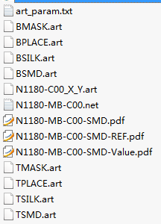


Backup files
File 1: N0000-XX-XXX-cad.zip (CAD file)
File 2: N0000-XX-XXX-gerber.zip
Valor open/short report(.txt)
IPC(.ipc)
Impedance reference gerber (DIF_REF_L3.art)
panel reference gerber (T/Bsmd-ref.art)
All gerber files
File 3: N0000-XX-XXX-pads.zip (Pads PCB)
File 4: N0000-XX-XXX-smd.zip
Netlist file(.net)
SMD gerber (MASK, SMD, PLACE, SILK, X_Y)
SMD-REF DES PDF file(.pdf)
SMD-Value PDF file(.pdf)
File 5: N0000-XX-XXX-spc.zip
PCB制作要求
SMD-REF DES PDF file(.pdf)
Notation
File 6: N0000-XX-XXX-v166-brd.zip
Allegro board file
EE & ME materials & Panel
Guideline and stack up
EQL report and others

